Slide 1


TOPIC 7:
Demonstration of types of
viruses and its mechanism
Team 3:
Pham Thanh Truong 20194460 Phan Manh Tuan 20194461
UseCase diagram
Build screen
Build controller
Fix some parts in model parts
Class Diagram
Build package Virus
Build package Cell
Fix some parts in GUI

Slide 2
Problem statement
Design application with these properties:
On MainScreen:
Users can choose to investigate a virus with lipid envelope or virus without envelope
Help menu contains “usage”, “aim of application” and “problem”.
On StructureScreen (after choosing a virus ): User will see general structure
Slide mouse to a part to explore and click to see detail
A button “infect” to see infecting process
On InfectingScreen (after choosing “infect” button): Show infecting process

Slide 3
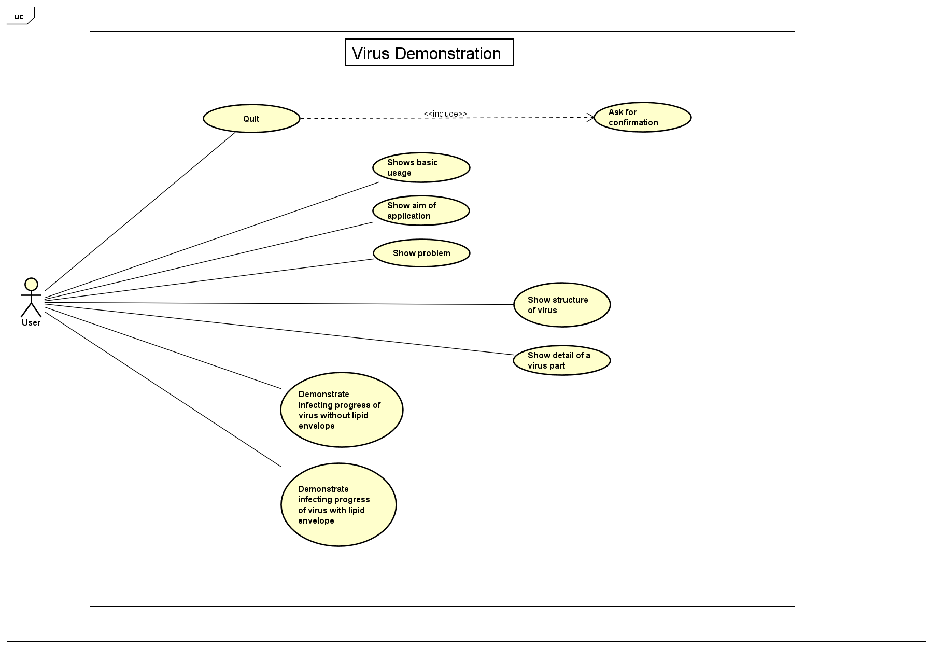
UseCase Diagram

Slide 4
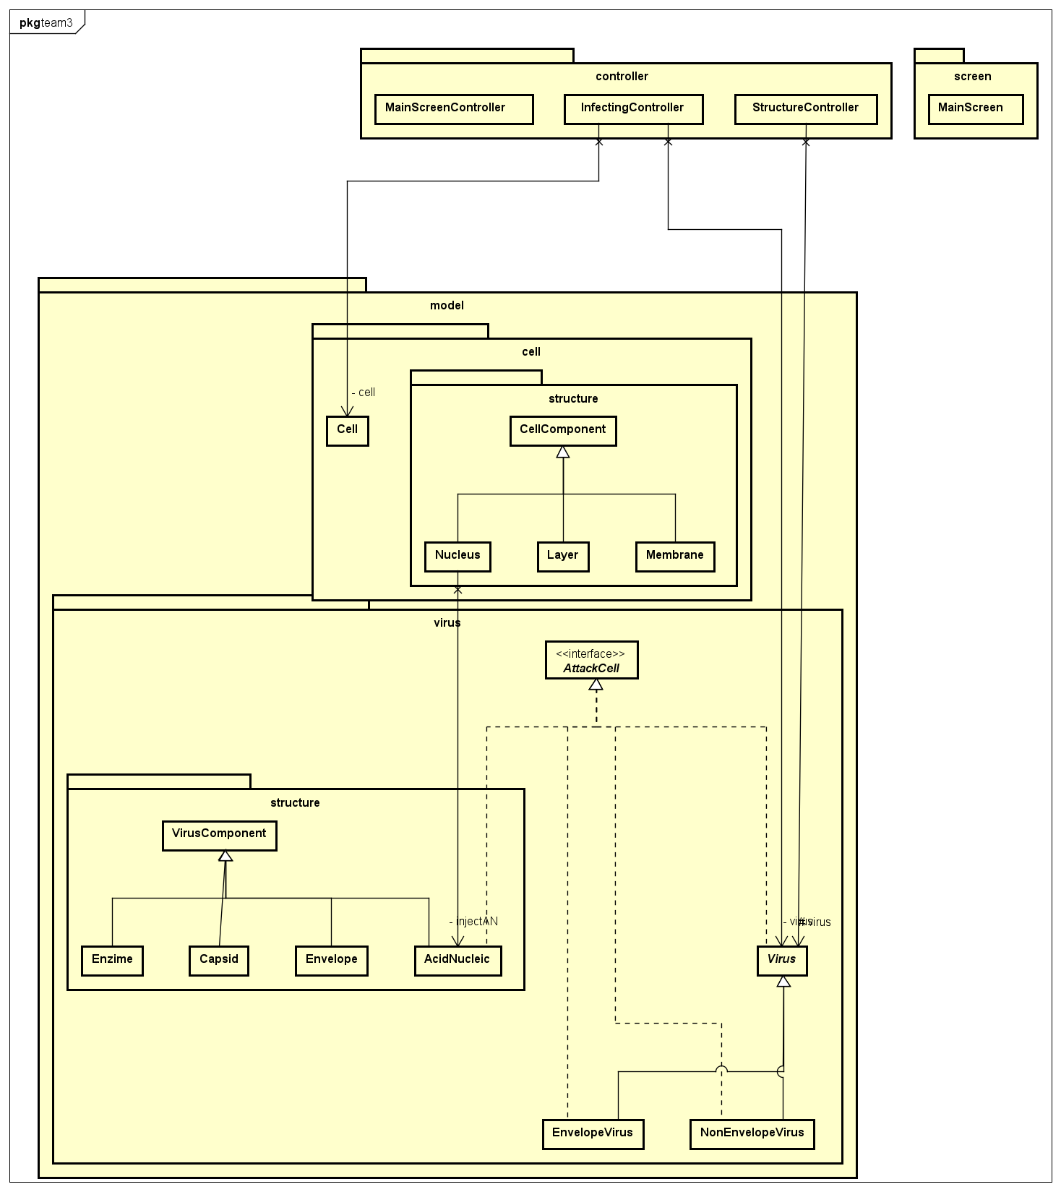
General Class Diagram

Slide 5
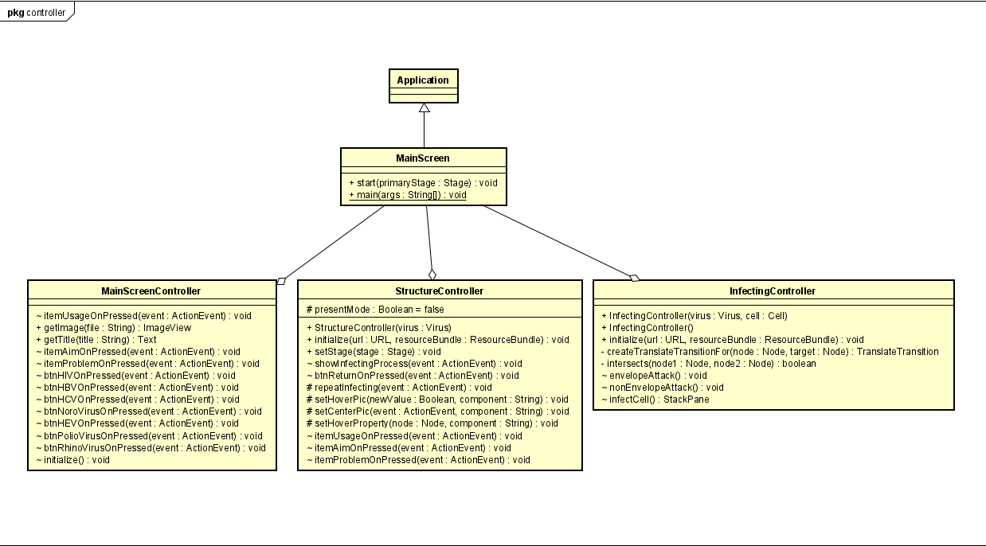
Detail Class Diagram

Slide 6
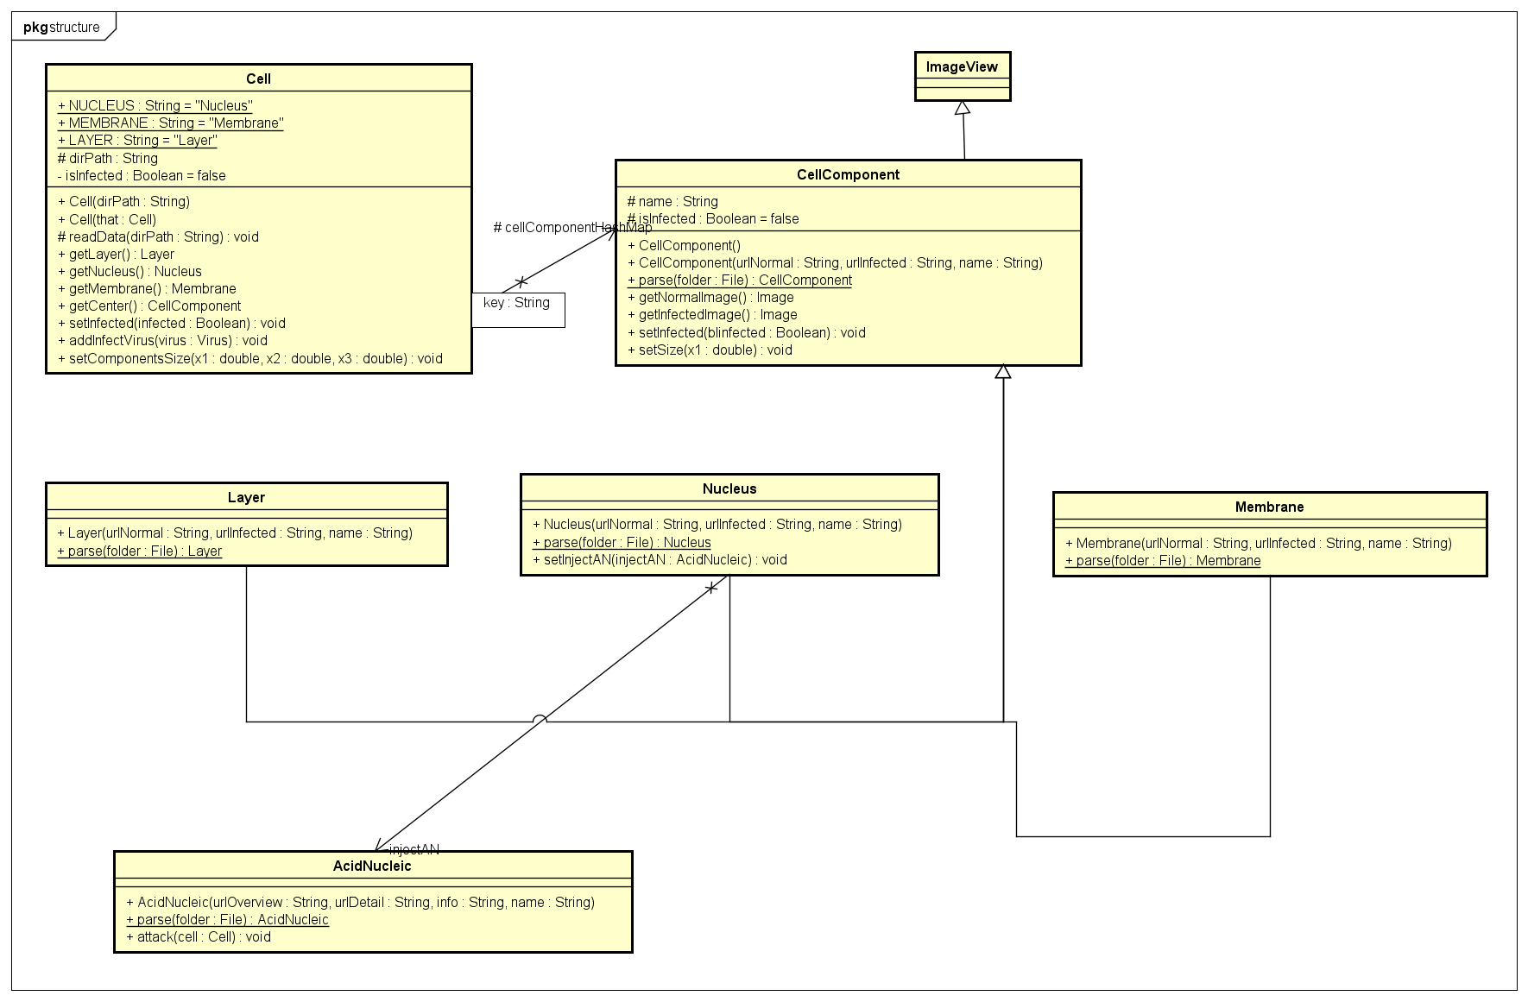
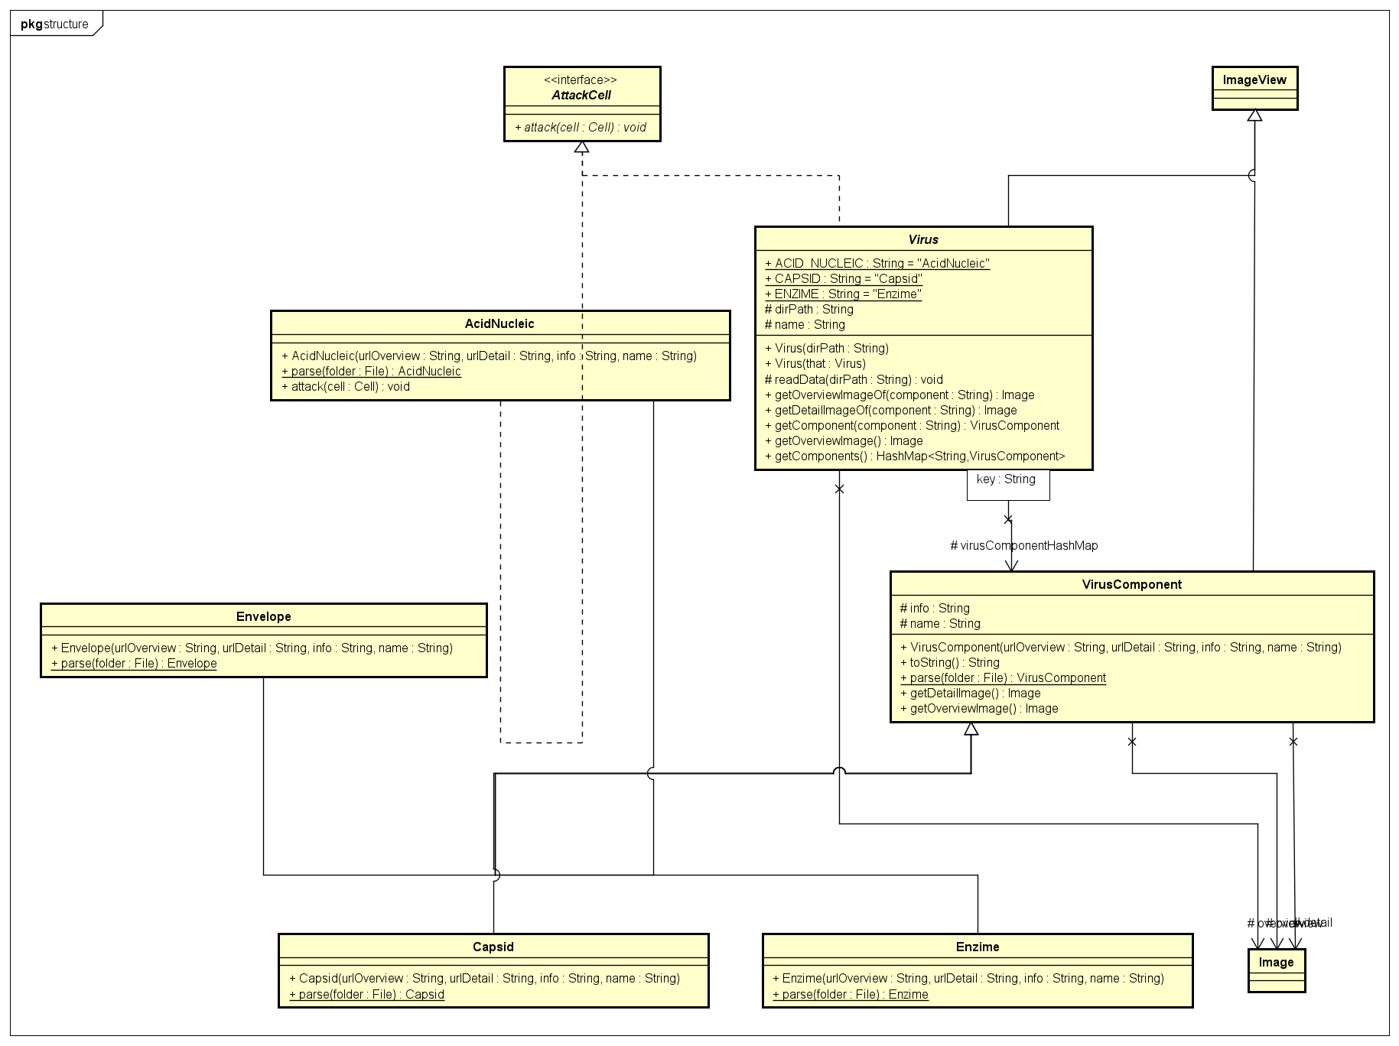
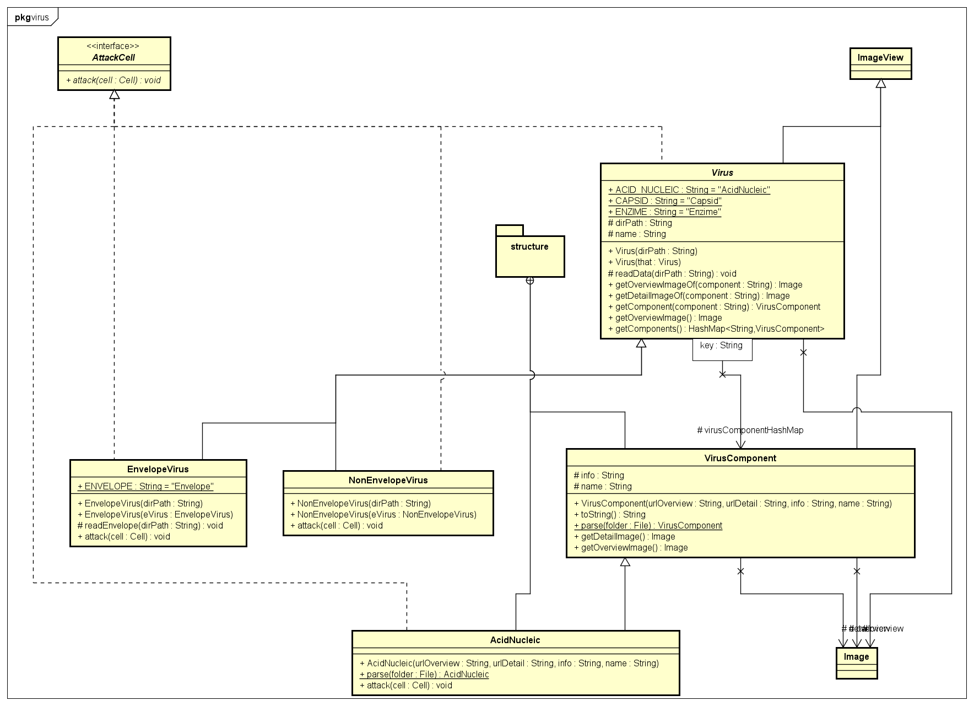
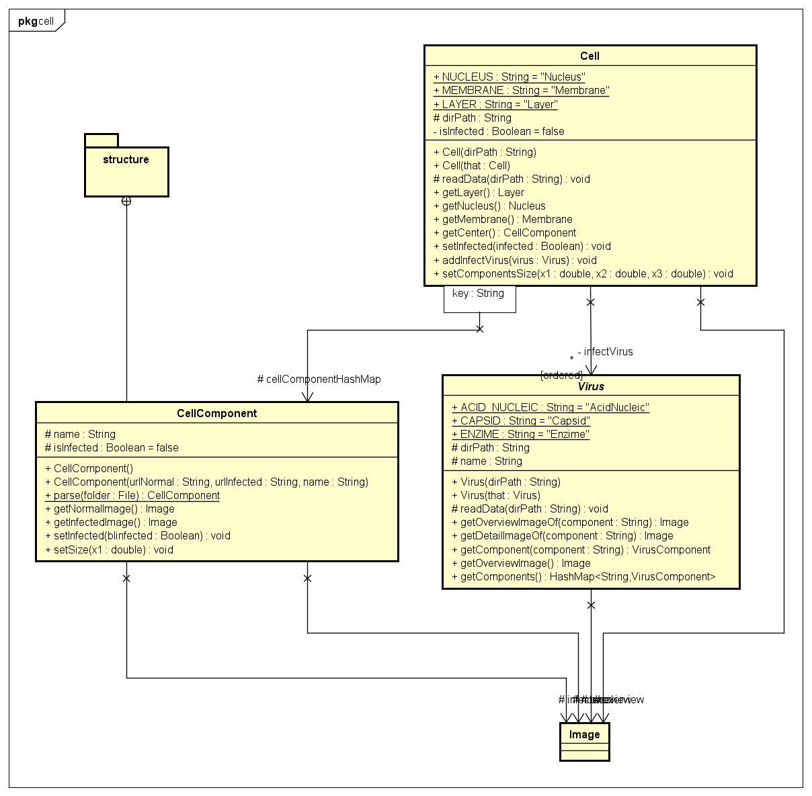
Detail Class Diagram

Slide 7
OOP Techniques
Polymorphism :
Attack : Many way to attack (Virus with envelope, Virus without envelope, Nucle)
Encapsulation:
Connect through public method (GetImageOf, getComponentOf ... )
Abstraction:
Abstract class Virus
Thinking in general terms rather than specific term ( Virus components)

Slide 8
OOP Techniques
Inheritance:
NonenvelopeVirus, EnvelopeVirus inheritate from Virus
Parts of Cell: Layer, Membrance, Nucleus inheritate from CellComponent
Parts of Virus: AcidNucleic, Enzime, Capsid, Envelope, ... Inheritate from VirusComponent
Aggregation:
Virus has many Virus Components
Cell has Cell Components

Slide 9
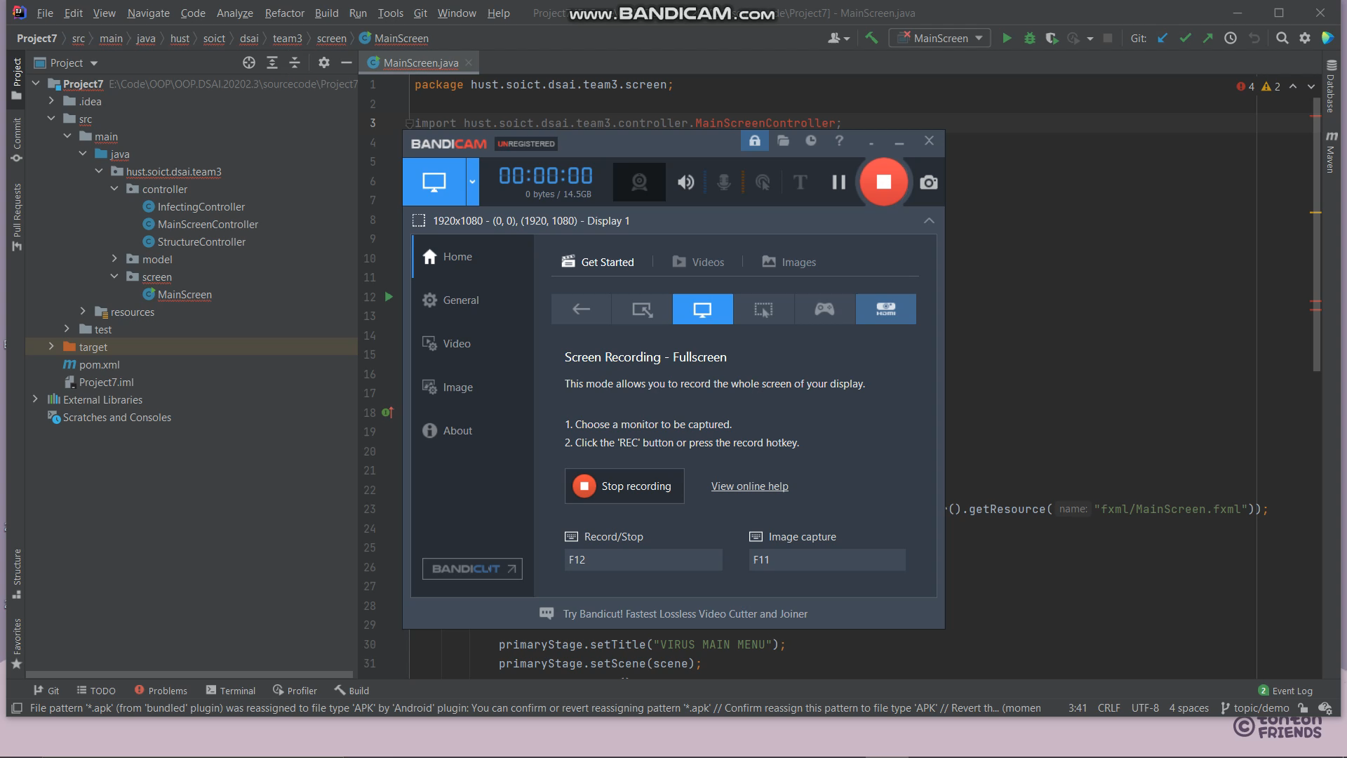
Demo Scenario
Click here to see Demo

